Slide 1
SKKU Parking Guide
Real-Time Parking App
Weekly Progress
Team I-dle Kim Seheon Kim Hyeongjin Noh Hayeon Park Inchan

Slide 2
Contents
Project Overview
Weekly Progress
Front-end / Data Preprocessing / AI Model
Future Plan
Next steps for project advancement
Team Contributions

Slide 3
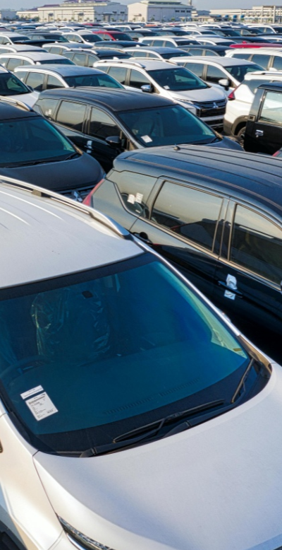
Project Overview
#1
Parking management system uses
to detect car park vacancies
Technical Background
1. YOLOv5:
real-time analysis of parking spaces and vehicle sizes.
2. Camera and AI integration system:
Data collected by cameras is processed by AI model, stored in a database, and linked to a mobile app.

Slide 4
Weekly Progress
#2
~Week5 | Week6 | Week7~
proposal...
Data Preprocessing
UI/UX Design, App Front-end
Model Train

Slide 5
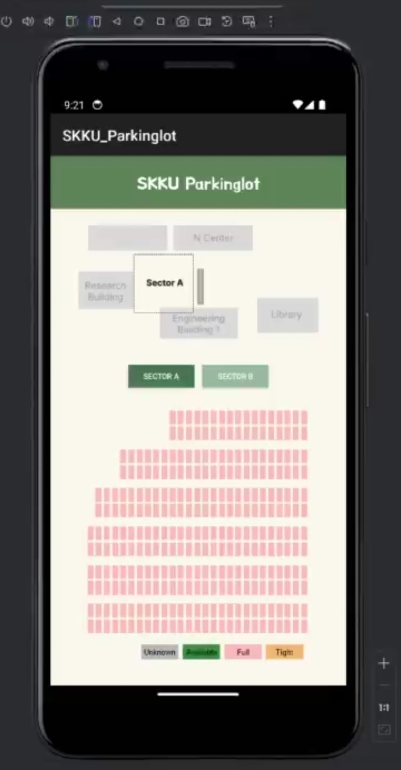
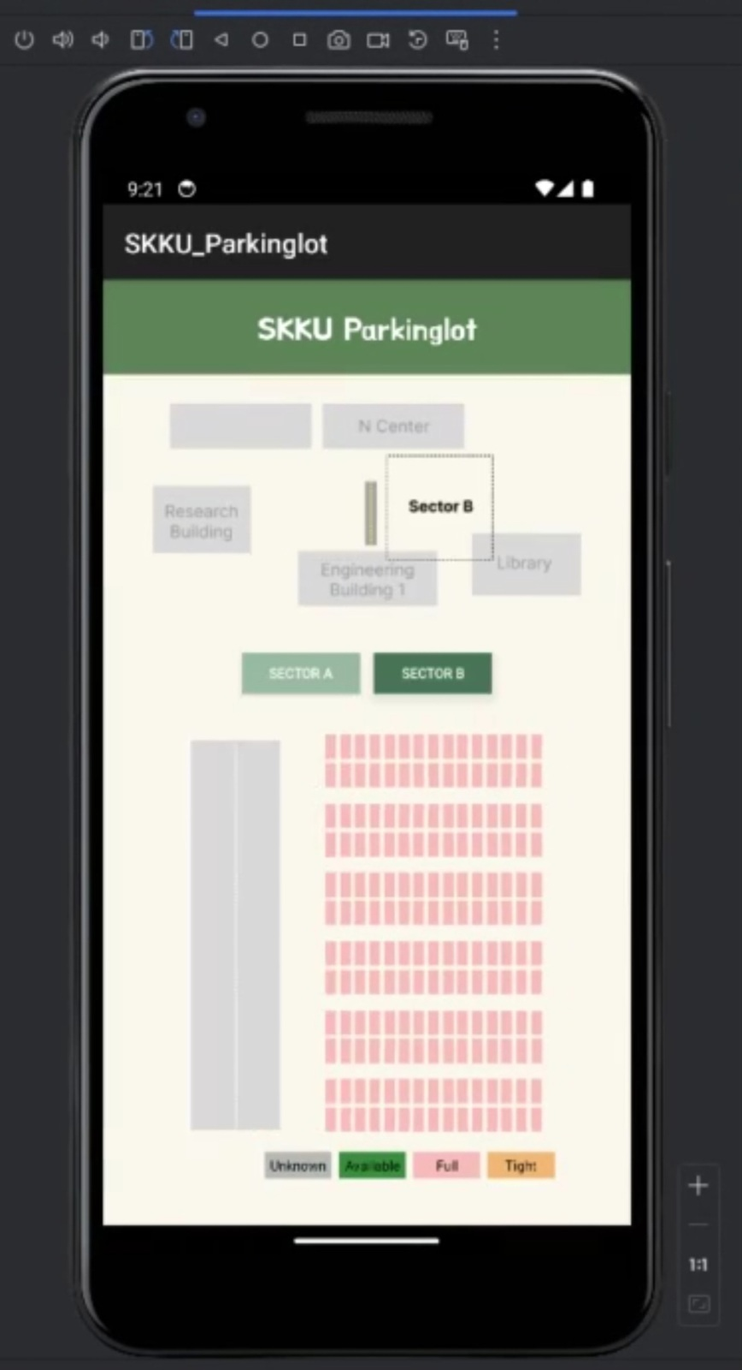
Front-end
#2.1
Completed the basic configuration of the app based on the design.
Designed an intuitive UI to provide users with real-time parking space information.

Slide 6
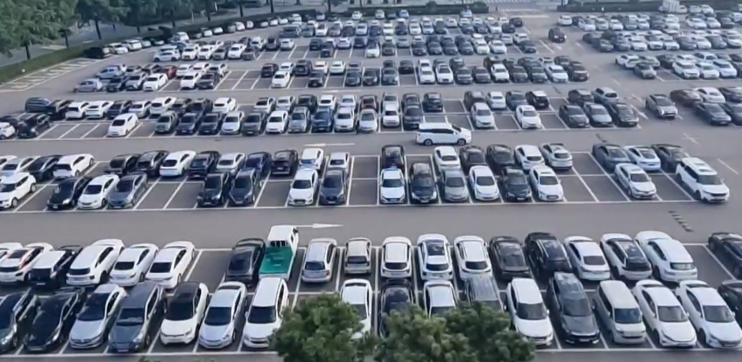

Data Preprocessing
#2.2
Labelling parking space coordinates
Collecting training data
Filming a video of SKKU parking lot for testing

Slide 7
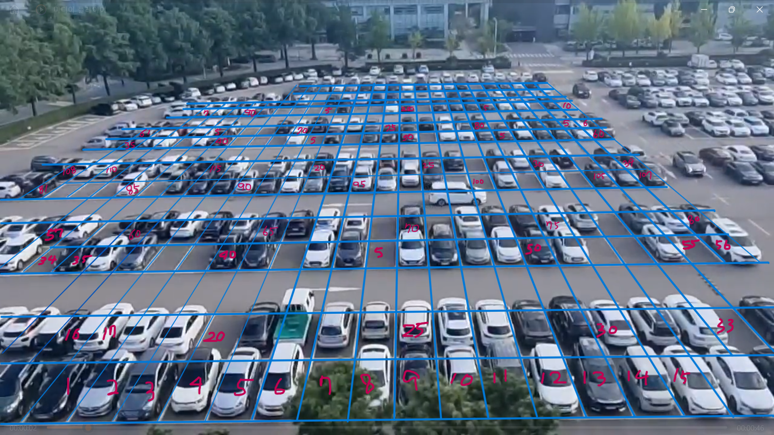
Data Preprocessing
#2.2
Labelling parking space coordinates
Collecting training data
Filming a video of SKKU parking lot for testing

Slide 8

AI Model
#2.3
01.
02.
03.
Data collecting PKLot Dataset
Fine-tuning the pretrained YOLOv5 model
Test with a screenshot of our parking lot

Slide 9
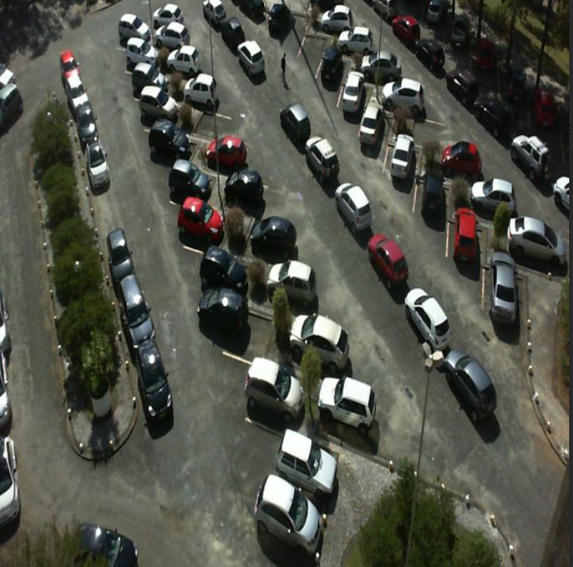
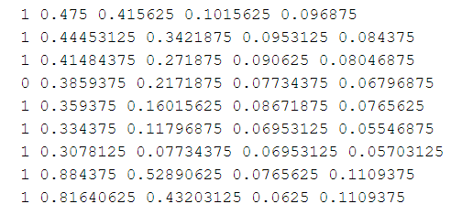
AI Model – Data Collecting
#2.3.1
Image dataset of parking lots extracted from surveilance camera frames
Train: 8691, Valid: 2483, Test:1242
Dataset: {images, labels}
{label, coor}
{image}

Slide 10
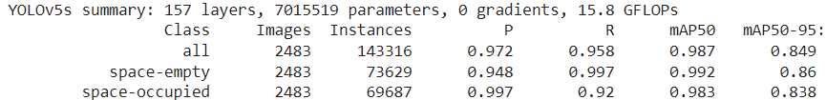
AI Model – Fine tuning
#2.3.2
Train with 10 epochs
P(Precision): correctly predicted objects / the total number of objects predicted by the model
R(Recall): actual objects detected by the model / the total number of real objects
mAP50: Mean Average Precision when the Intersection over Union (IoU) is above 0.5

Slide 11
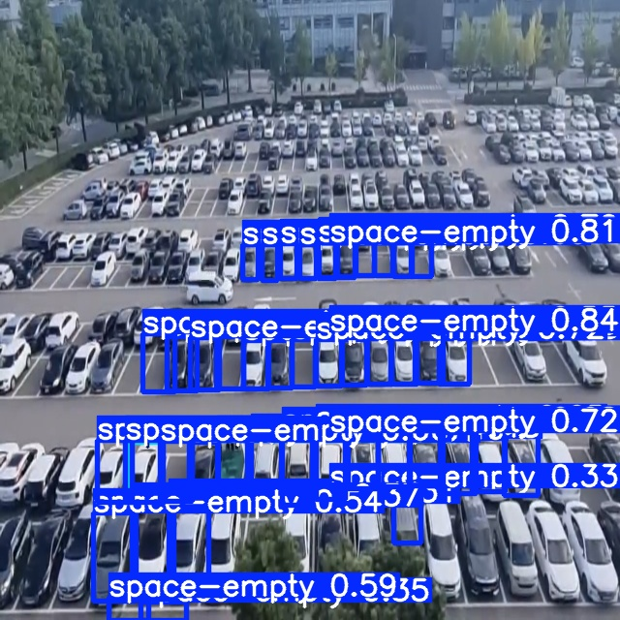
AI Model – Test with our data
#2.3.2
Did not worked well… ☹
Possible solution:
- Make SKKU parking lot dataset
- Test with smaller area

Slide 12
Future Plan
#3
App Back-end
Cloud-based database to store and synchronise car park data in real-time
Integrate Model with App
01.
02.
03.
04.
05.
Model Train
Model Evaluation
Testing & Revision
1. Need to train the model to recognize the size of car
2. Improve the model to achieve high accuracy even with video

Slide 13
Team Contributions
Kim Seheon
Kim Hyeongjin
Noh Hayeon
#4
Park Inchan
Team Leader
Front-end Development
Find
Parking Spot Coordinates and Label
Training and Testing AI Models (YOLOv5)
Data Collecting
Model Modifying

Slide 14
Thank You

